Slide 1
Diagnosis of breast cancer by Bayesian Logistic Regression
BDA Project Presentation
Jonne Kurokallio
Ales Suchomel
14. 12. 2020

Slide 2
Introduction
Breast cancer is one of the most common cancers in the world
In Finland approx. 5000 women are diagnosed yearly
Demand for accurate measurements and diagnosis tools is high
In this project we present multiple logistic models to tackle binary breast cancer classification task.
Models are compared using leave-one-out cross-validation
Predictive performance was evaluated on the best model

Slide 3
Breast cancer Wisconsin dataset
General:
Available from UCI and kaggle
Relatively widely used for binary classification
Resulting accuracy often > 95
Not aware of any previous use of Bayesian methods
Characteristics:
569 measurements of fine needle aspiration extractions
10 numerical features describing the tumor’s shape and size
2 diagnosis malignant (212) and benign (357)

Slide 4
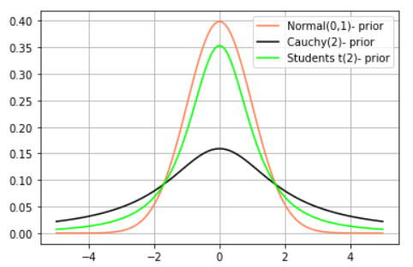
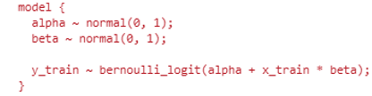
Models
Base models:
Bayesian logistic regression
Linear correlation between features and predictions
Binarized by Bernoulli
Differ by priors and number of parameters (data features)
Priors:
Weakly informative
Different scales tested but always centered to zero
Fig 1: Stan code for logistic regression with Normal priors.
Fig 2: Plot of tested prior distributions (Normal, Cauchy, Student’s).

Slide 5
Data processing pipeline
Data preprocessing (standardization, feature selection, PCA)
set of 6 different datasets (Origin, Stand, Custom-5, PCA-all, PCA-6, PCA-3)
Data splitting (setting apart 20 percent of points for final evaluation)
train and test sets of the prepared datasets
Stan model compilation (classifiers differentiated by priors, flexible regarding feature counts)
set of 3 interchangeable StanModel objects (Normal, Student-T, Cauchy)
Default sampling (all combinations of models with train datasets)
many warnings (divergences, Rhat > 1.1, khat > 0.7, tree depth saturation)
Tuning stan options (finally setting max_treedepth = 15, iter_count = 2200, rest to default)
only few warnings regarding khat > 0.7
Generating posterior draws (all combinations of models with both test and train datasets)
set of 18 StanFit4Model objects with point-wise log-likelihoods and predicted labels for both splits

Slide 6
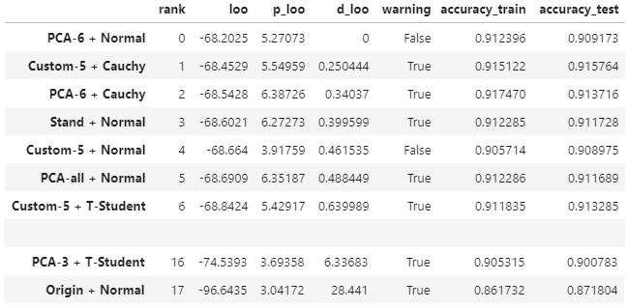
Comparison and sensitivity
No significant differences in scores (elpd, accuracy) for most dataset-prior combinations.
The classification is robust to changes in priors and preprocessing.
Other findings:
both train and test accuracies are consistently around 0.91
most of elpd values (‘loo’ column) differ only insignificantly
standardization is necessary
5 features are enough
warnings are not fully eliminated
dataset + prior
Fig 3: Table comparing scores reached by sampling all combinations of priors and datasets.

Slide 7
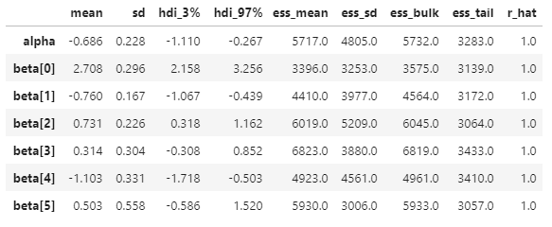
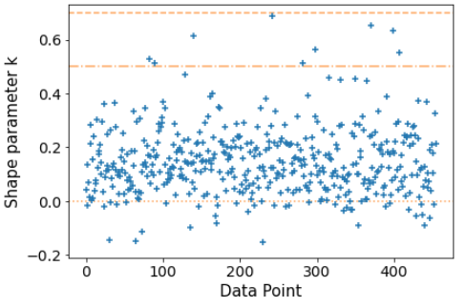
Detailed characteristics
of logit classifier with Normal prior trained on the first 6 PCs (PCA-6 + Normal).
Often cause warnings
Fig 4: Table summarizing the resulting statistics and diagnostics of the Normal-prior model parameters trained on the PCA-6 dataset.
Fig 5: Scatter plot of khat diagnostics of the Normal-prior model trained on the PCA-6 dataset.

Slide 8
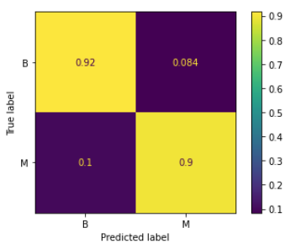
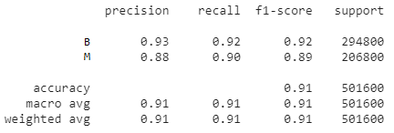
Predictive performance
of logit classifier with Normal prior trained on first 6 PCs (PCA-6 + Normal).
Fig 6: Classification scores of Normal-prior model for test split of PCA-6 dataset.
10 % of malignant tumors uncaught is a problem...
Fig 7: Confusion matrix of Normal-prior model for test split of PCA-6 dataset. Horizontally normalized.

Slide 9
Conclusions
Logit-based binary classifiers with 3 different prior distributions were successfully fit using pystan.
The resulting model is robust, its accuracy is decent, but not sufficient for practical use.
Test different link functions (e. g. probit)
Compute the probability of a tumour being malignant
Improved accuracy could be achieved by better feature engineering.
Improvements

Slide 10
Further information
Detailed report along with the source codes are available from
https://github.com/kurokaj/BDA_project.
Contact information:
Ales Suchomel – suchoale@fjfi.cvut.cz
Jonne Kurokallio – jonne.kurokallio@aalto.fi

Slide 11
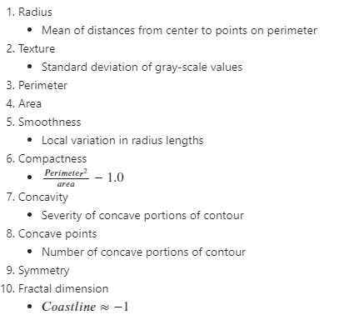
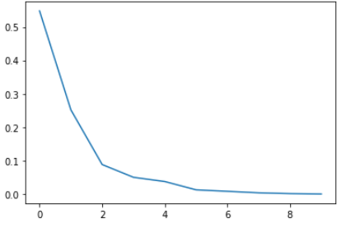
Appendix – Data
Fig 8: Plot of explained ratios of all principal components.
Fig 9: Feature description.

Slide 12
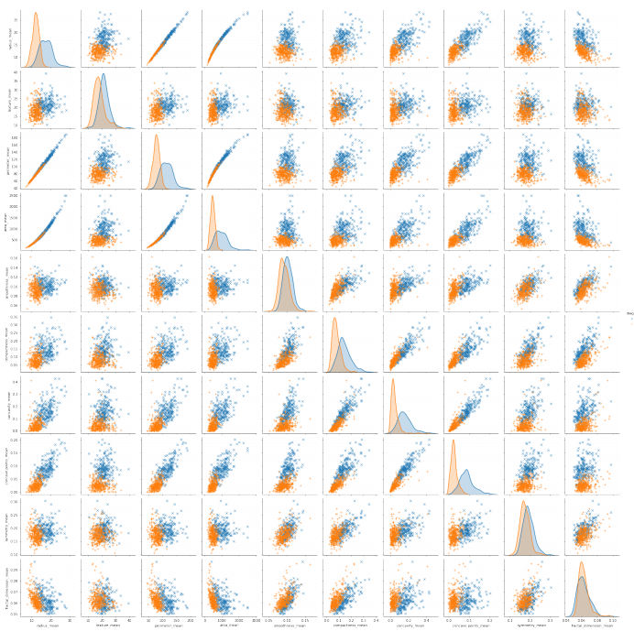
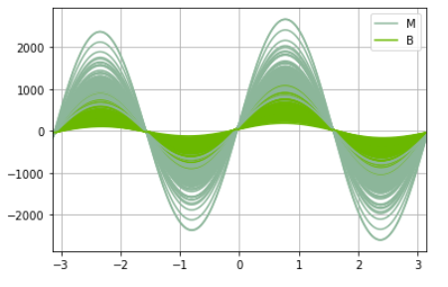
Appendix – Data
Fig 10: Plot of Andrew curves for both classes (M and B).
Fig 11: Pair-wise scatter plots and relative distributions of all features. Points are colored by diagnosis.

Slide 13
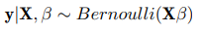
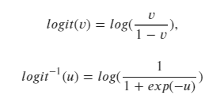
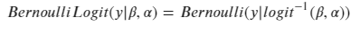
Model formulation
Bayesian formula
Likelihood
Correlation eq.
Logistic formulation

Slide 14
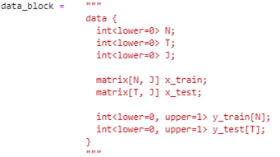
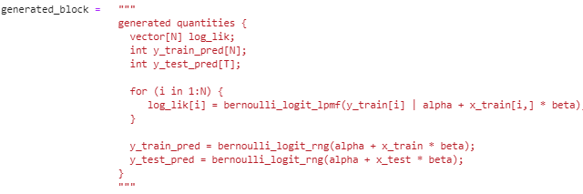
Appendix – Stan code

Slide 15
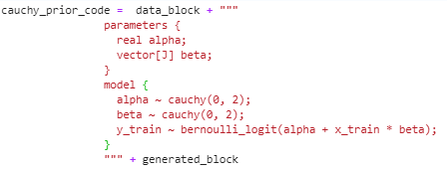
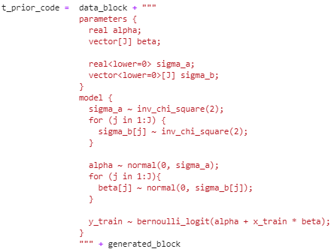
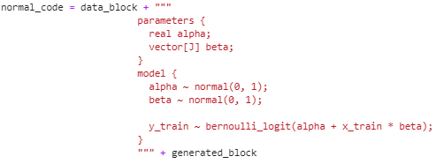

Slide 16
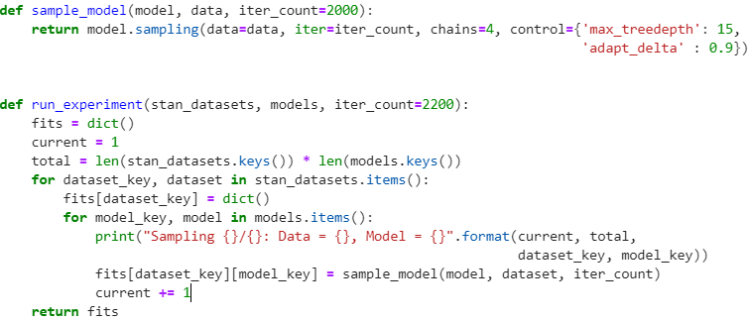
Appendix – Run code

Slide 17
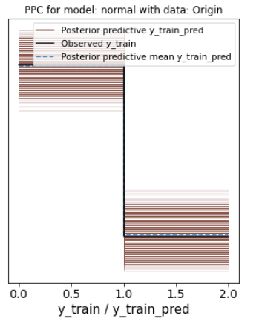
Appendix - Posterior predictive check

